Slide 1
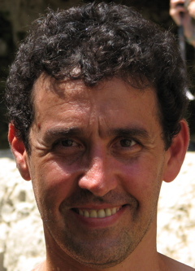

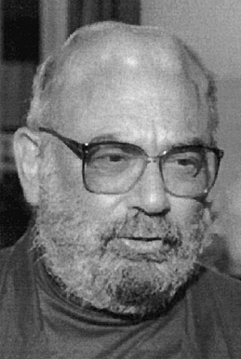
Tree-based Methods for Classification & Regression
Boosting
Yoav Freund, Rob Schapire Leo Breiman
UC San Diego Princeton UC Berkeley
Notes:
Boosting is a related alternative to bagging and random forests. Boosted trees are also ensemble classifiers. That is, many classifiers are fit to the data, and their predictions combined. In bagging and Random Forests the samples are drawn from the data at the beginning before any classifiers are fit to the data; in boosting, the “datasets” are modified sequentially.

Slide 2
Tree-based Methods for Classification & Regression
Boosting
Schapire,1990, The Strength of Weak Learnability
Freund & Schapire, 1996, Experiments with a new Boosting Algorithm
Breiman, 1997, Arcing Classifiers
Schapire et al. 1997, Boosting the Margin
Breiman, 1997, Arcing the Edge
Freund & Schapire, 1998, Game Theory Online Prediction and Boosting
Breiman, 1999, Prediction Games and Arcing Algorithms
Notes:
The story—and there is a good story here—begins with Rob Schapire and Yoav Freund, who were working in the general area of classification, and who came up with an algorithm they called adaboost. That’s the 1996 paper entitled, Experiments with a New Boosting Algorithm. Leo Breiman was a very senior and well-known researcher in statistics and machine learning. Breiman immediately saw the potential of boosting and extended Freund and Schapire’s results. What was unusual was that he chose to completely change the terminology. Freund and Schapire used standard computer science terminology such as boosting and the margin; Breiman used the terms arcing and the edge, respectively, for the same concepts. They alternated papers throughout the latter part of the 1990s. Freund and Schapire, who were quite young at the time, could have been forgiven for wondering why this senior leader of the field hated them so much as to completely change their terminology. In fact the opposite was true: Breiman was a great admirer of their work and at some point described adaboost as the best off-the-shelf classifier in the world. When they finally all met up, Freund, Schapire, and Breiman got on very well.

Slide 3
Tree-based Methods for Classification & Regression
Boosting
A “weak learner” is a simple classifier that does just a little better than guessing (e.g., a small tree).
Combining lots of “weak classifiers” can do much better than a single weak classifier.
In classification, what goes on near the class boundary is crucial.
Fit lots of weak learners, putting more weight on points that were misclassified last time around.
Combine the weak learners, giving more weight to the ones that fit well (i.e., had a small error rate).

Slide 4

Tree-based Methods for Classification & Regression
Boosting
Training sample ➾ $f_{1}(x)$
Weighted sample ➾ $f_{2}(x)$
Weighted sample ➾ $f_{3}(x)$
Combine $f_{1}\left(x\right), ⋯,f_{M}\left(x\right)$➾ $f(x)$
$⋮$
Weighted sample ➾ $f_{M}(x)$
Notes:
Schematically, we may think of boosting as looking something like this. We start by fitting a weak classifier to a (training) dataset. The points that are misclassified are upweighted in the second dataset, and a second classifier is fit. This process continues for many iterations (M in the slide). Finally the results for the M classifiers are combined to give a more accurate prediction. In combining the results the classifiers that had lower error rates receive more weight than the classifiers that had higher error rates.

Slide 5
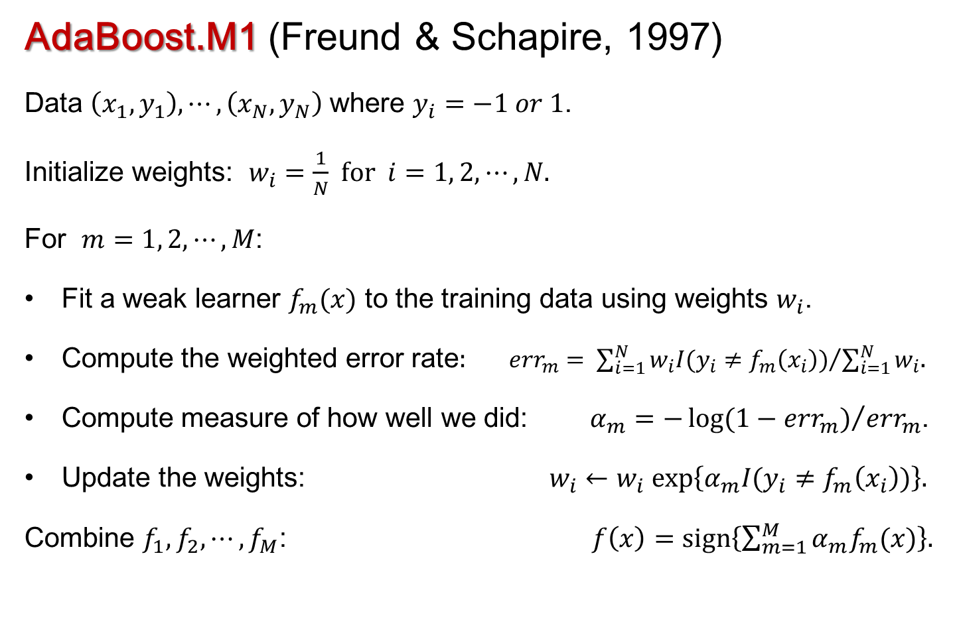
Tree-based Methods for Classification & Regression
AdaBoost.M1 (Freund & Schapire, 1997)
Data $\left(x_{1},y_{1}\right),⋯,\left(x_{N},y_{N}\right)$ where $y_{i}=−1 or 1$.
Initialize weights: $w_{i}=\frac{1}{N}$ for $i=1, 2, ⋯, N.$
For $m=1, 2, ⋯, M$:
Fit a weak learner $f_{m}(x)$ to the training data using weights $w_{i}$.
Compute the weighted error rate: ${err}_{m}= {\sum_{i=1}^{N}{w_{i}I(y_{i}≠f_{m}\left(x_{i}\right))}}/{\sum_{i=1}^{N}{w_{i}}}$.
Compute measure of how well we did: $α_{m}={−\log{(1−{err}_{m})}}/{{err}_{m}}$.
Update the weights: $w_{i}←w_{i} exp\left\{α_{m}I(y_{i}≠f_{m}\left(x_{i}\right))\right\}.$
Combine $f_{1}, f_{2}, ⋯, f_{M}$: $f\left(x\right)=sign\left\{\sum_{m=1}^{M}{α_{m}f_{m}(x)}\right\}$.
Notes:
The adaboost algorithm is one of the simpler boosting algorithms to understand. Initially all observations in the training data have the same weight. A weak classifier is fit to the data and the misclassification rate (error) rate, ${err}_{1}$ is computed. From that $α_{1}$ is computed and is used to upweight the observations that were misclassified. Next, another weak learner is fit to the weighted data. A weighted error rate is computed, and $α_{2}$, and the misclassified observations have their weights increased. The process continues for as many iterations as the user desires. The final step is to compute a weighted sum of the predictions for each observations and round the sum to 1 or -1.

Slide 6
Tree-based Methods for Classification & Regression
Boosting
Note:
The “weak learner” is a simple classifier. E.g., two node trees (“stumps”).
The weak learners deliberately underfit the data
Initially, people thought boosting could not overfit, later it was found that it can overfit, usually only after a very large number of iterations.
In early work, the weights were used for sampling, later as observation weights for the weak learner.
Boosting reduces both the variance and bias of the weak learner.
Notes:
My observation in using adaboost over many years is that it works surprisingly well without any tuning.

Slide 7



Tree-based Methods for Classification & Regression
Boosting
Jerome Friedman Trevor Hastie Rob Tibshirani
Stanford Stanford Stanford
“Additive Logistic Regression: A Statistical View of Boosting” The Annals of Statistics, 2000.
Showed AdaBoost fits an additive model, optimizing a novel exponential loss
function that is very similar to the negative of the binomial log-likelihood.
Notes:
Intuitively one can see what adaboost is doing and it makes sense but how is it related to other statistical procedures? Friedman, Hastie and Tibshirani explored this question and showed that adaboost was close to being an additive logistic regression model with an unusual loss function (measuring fit). The next obvious question was, “How might one improve adaboost from a statistical perspective?” Jerry Friedman picked up that question and his research resulted in a paper in the Annals of Statistics in 2001 (the same year Random Forests was published) entitled, “Greedy Function Approximation: the Gradient Boosting Machine.”

Slide 8
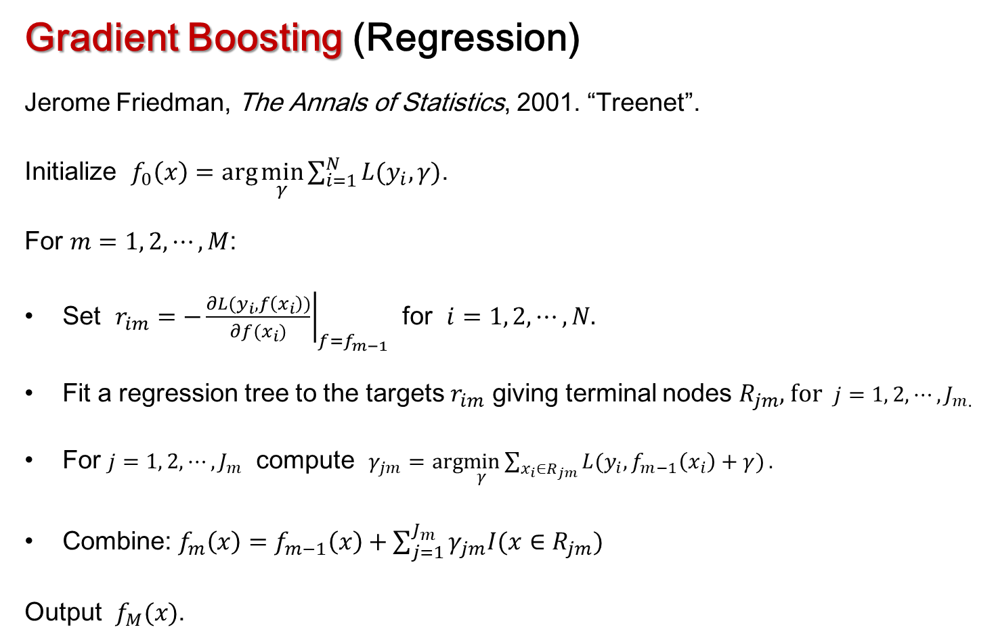
Tree-based Methods for Classification & Regression
Gradient Boosting (Regression)
Jerome Friedman, The Annals of Statistics, 2001. “Treenet”.
Initialize $f_{0}\left(x\right)=arg\min_{γ}{\sum_{i=1}^{N}{L(y_{i},γ)}}$.
For $m=1, 2, ⋯, M$:
Set $r_{im}=−{\left.\frac{∂L(y_{i},f\left(x_{i}\right))}{∂f(x_{i})}\right|}_{f=f_{m−1}}$ for $i=1, 2, ⋯, N$.
Fit a regression tree to the targets $r_{im}$ giving terminal nodes $R_{jm}$, for $j=1, 2, ⋯, J_{m}$.
For $j=1, 2, ⋯, J_{m}$ compute $γ_{jm}=arg\min_{γ}{\sum_{x_{i}∈R_{jm}}{L(y_{i},f_{m−1}\left(x_{i}\right)+γ)}}.$
Combine: $f_{m}\left(x\right)=f_{m−1}\left(x\right)+\sum_{j=1}^{J_{m}}{γ_{jm}I(x∈R_{jm})}$
Output $f_{M}(x)$.
Notes:
I have put this slide with a general version of the gradient boosting algorithm for regression in for completeness. It is easier to see what is going on by taking the special case of square error loss (minimizing residual sum of squares) for regression.

Slide 9
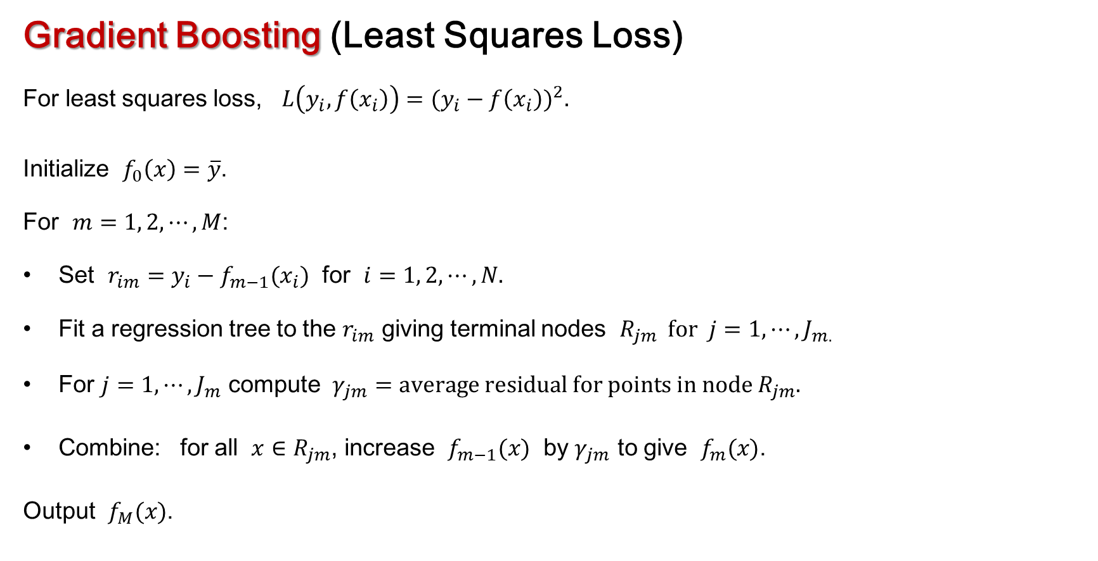
Tree-based Methods for Classification & Regression
Gradient Boosting (Least Squares Loss)
For least squares loss, $L\left(y_{i},f\left(x_{i}\right)\right)={(y_{i}−f\left(x_{i}\right))}^{2}.$
Initialize $f_{0}\left(x\right)=\overline{y}$.
For $m=1, 2, ⋯, M$:
Set $r_{im}=y_{i}−f_{m−1}(x_{i})$ for $i=1, 2, ⋯, N$.
Fit a regression tree to the $r_{im}$ giving terminal nodes $R_{jm}$ for $j=1, ⋯, J_{m}$.
For $j=1, ⋯, J_{m}$ compute $γ_{jm}=average residual for points in node R_{jm}$.
Combine: for all $x∈R_{jm}$, increase $f_{m−1}(x)$ by $γ_{jm}$ to give $f_{m}(x)$.
Output $f_{M}(x)$.
Notes:
We start by fitting a tree of some specified size (depth) to the data. We compute the residuals and fit a tree to the residuals, and augment the predictions from the initial tree with values from the new tree. And we repeat the process many times. Adaboost involved updating weights on the observations in a sequential way but GBM recursively fits trees to residuals that are recomputed at each step.

Slide 10
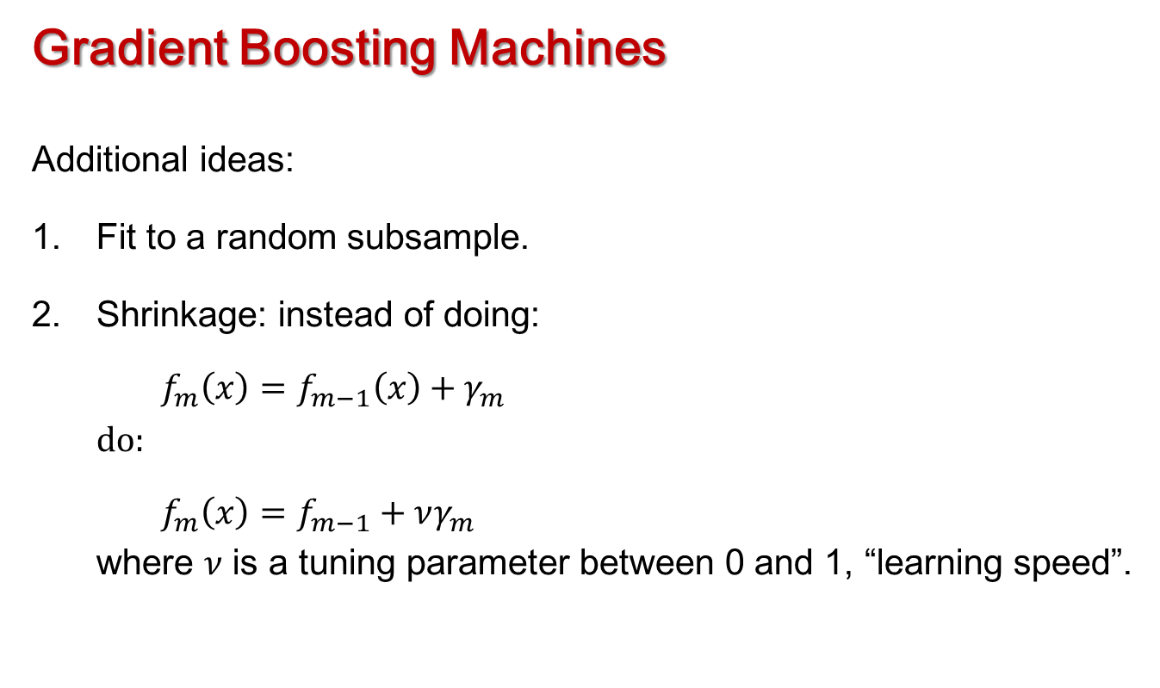
Tree-based Methods for Classification & Regression
Gradient Boosting Machines
Additional ideas:
Fit to a random subsample.
Shrinkage: instead of doing:
$f_{m}\left(x\right)=f_{m−1}\left(x\right)+γ_{m}$
do:
$f_{m}\left(x\right)=f_{m−1}+νγ_{m}$
where $ν$ is a tuning parameter between 0 and 1, “learning speed”.
Notes:
There are several parameters in gradient boosting and, unlike Random Forests, they do need to be optimized with respect to cross-validated error. One parameter is the number of trees, another is the depth (size) of the trees that are fit, a third is a sort of shrinkage applied to the augmentation to the original predictions and, finally, the minimum number of observations in each terminal node of each tree. Moreover, these parameters are not independent: fitting lots of small trees can give the same accuracy as fitting a much smaller number of larger trees.

Slide 11
Tree-based Methods for Classification & Regression
Example: Cavity nesting birds, crossvalidated accuracies for previous pruned tree and other methods with default parameters.
Note: 5000 trees were used for gbm.
Method | PCC | Specificity | Sensitivity | K | AUC
Pruned tree | 83.1 | 81.1 | 85.1 | .662 | .838
Tree | 82.6 | 86.8 | 78.5 | .653 | .826
AdaBoost | 83.6 | 81.1 | 86.0 | .671 | .836
GBM | 77.9 | 77.4 | 78.5 | .559 | .779
Forests | 84.0 | 84.0 | 84.1 | .681 | .840
Notes:
The next few tables compare the accuracies of adaboost and gradient boosting to Random Forests, a tree constructed using the 1-SE rule and a somewhat larger tree. In this cavity nesting birds example adaboost has about the same accuracy as Random Forests, the individual classification trees are very close behind, and GBM does poorly relatively. But this is GBM using default parameter values.

Slide 12
Tree-based Methods for Classification & Regression
Example: Cavity nesting birds, crossvalidated accuracies for previous pruned tree and other methods with parameters selected by tuning
Method | PCC | Specificity | Sensitivity | K | AUC
Pruned tree | 83.1 | 81.1 | 85.1 | .662 | .838
Tree | 82.6 | 86.8 | 78.5 | .653 | .827
AdaBoost | 83.1 | 83.0 | 83.2 | .662 | .831
GBM | 85.5 | 84.9 | 86.0 | .709 | .854
Forests | 84.5 | 84.9 | 84.1 | .690 | .845
Notes:
In this table we have tuned gbm in R using the package caret. It now has the highest cross-validated accuracy, albeit by a small margin over Random Forests.

Slide 13
Tree-based Methods for Classification & Regression
Example: Lichen air quality data, pilot evaluation data (crossvalidated) for previous pruned tree and other methods with default parameters
Note: 5000 trees were used for gbm.
Method | PCC | Specificity | Sensitivity | K | AUC
Pruned tree | 77.3 (82.7) | 80.5 (92.2) | 68.8 (49.7) | .459 (.457) | .764 (.780)
Tree | 72.0 (83.0) | 81.4 (90.5) | 46.3 (56.7) | .278 (.490) | .638 (.736)
AdaBoost | 81.3 (84.3) | 88.2 (93.0) | 62.5 (54.0) | .515 (.508) | .753 (.735)
GBM | 80.0 (81.9) | 90.5 (96.3) | 51.3 (31.6) | .449 (.348) | .708 (.639)
Forests | 83.3 (83.8) | 90.9 (93.0) | 62.5 (51.9) | .556 (.489) | .767 (.724)
Notes:
For the lichen data the figures in black are for predictions onto the Pilot Random Grid data and the figures in blue, in parentheses are for cross-validation. Random Forests looks to be slightly better than adaboost and GBM (which has not been tuned).

Slide 14
Tree-based Methods for Classification & Regression
Example: Lichen air quality data, pilot evaluation data (crossvalidated) for previous pruned tree and other methods with parameters selected by tuning
Method | PCC | Specificity | Sensitivity | K | AUC
Pruned tree | 77.3 (82.7) | 80.5 (92.2) | 68.8 (49.7) | .459 (.457) | .764 (.780)
Tree | 72.0 (83.1) | 81.4 (88.7) | 46.2 (63.6) | .278 (.517) | .638 (.762)
AdaBoost | 81.3 (83.5) | 87.3 (90.8) | 65.0 (57.8) | .523 (.504) | .761 (.743)
GBM | 83.3 (84.0) | 89.6 (93.4) | 66.3 (51.3) | .567 (.493) | .779 (.724)
Forests | 83.0 (84.1) | 90.0 (93.1) | 63.8 (52.4) | .553 (.497) | .769 (.728)
Notes:
When the GBM is tuned using caret its accuracy is essentially the same as Random Forests, a little better than adaboost, and quite a lot better than a single tree.
Another interesting aspect of this table is that the cross-validated accuracies and the accuracies on the Pilot Random Grid data are nearly the same for adaboost, Random Forests, and GBM but for the individual trees the cross-validation estimated are a little higher than the accuracy estimates on the Pilot Random Grid data.
I should warn you that tuning gbm in caret (in R) is a finicky, frustrating, time consuming process. One almost never gets the grid right on the first attempt. For the lichen data, the final grid I used in the video demonstration of GBM was not the first one I tried: it was the seventh or eighth, and the whole process took well over an hour.
In may applications I have found that GBM and Random Forests often have the same classification accuracies and for that reason many people choose to use Random Forests over GBM because it requires no tuning. For regression applications, GBM is a much more accurate predictor than Random Forests and it is definitely worth the effort to tune it.

